Slide 1


WiFi Performance Analysis: Monitoring, Recording, and Reporting
This presentation provides a detailed analysis of WiFi performance, focusing on the importance of monitoring, recording, and reporting key network parameters. We will explore various tools, techniques, and visualization methods to optimize network connectivity and ensure a better user experience. By understanding and addressing the factors that impact WiFi performance, network engineers and IT professionals can proactively identify and resolve network issues, enhancing overall network efficiency.
by Shubha268

Slide 2

Introduction to WiFi Performance Analysis
WiFi performance analysis is essential for identifying and resolving network issues, ultimately optimizing connectivity for users. This analysis involves monitoring key parameters such as speed, latency, and signal strength to ensure optimal network function. Effective monitoring and reporting are enabled through tools and visualization techniques. Understanding the interplay between these elements is crucial for maintaining a robust and efficient wireless network. This presentation will delve into each aspect to provide a comprehensive overview of WiFi performance analysis.
Identify Network Issues
Optimize Connectivity
Efficient Monitoring
Pinpoint problems affecting WiFi performance.
Improve WiFi speed and reliability.
Use tools for real-time network analysis.

Slide 3
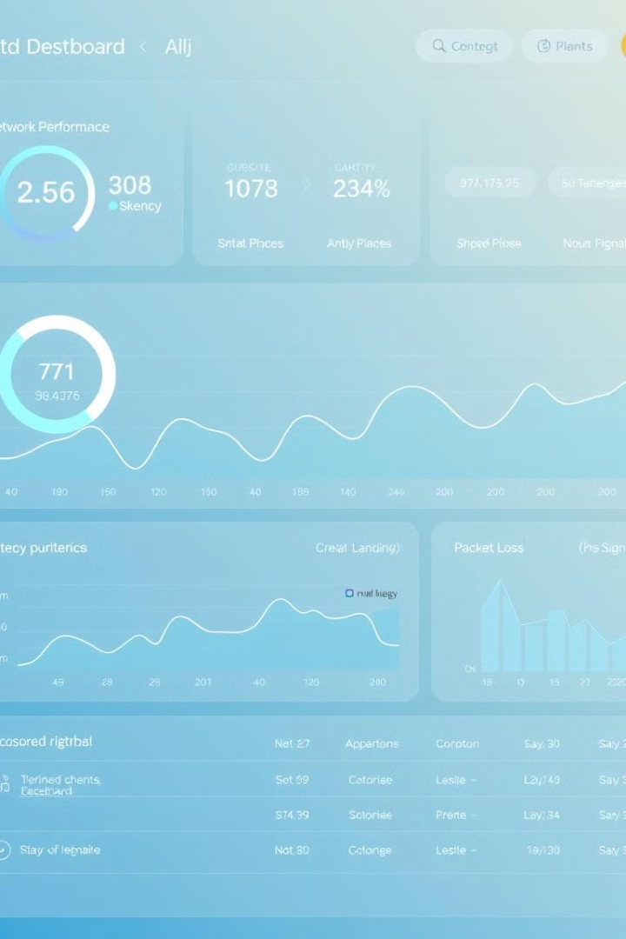



Key Performance Parameters
Several key performance parameters are crucial in evaluating WiFi performance. These include download and upload speeds, latency (ping time), packet loss, and signal strength (RSSI). Monitoring network congestion, interference levels, and video streaming performance also offers valuable insights into overall network health. These metrics help diagnose specific issues and guide optimization efforts. Accurate and consistent data collection is essential for effective analysis.
Download Speed
Upload Speed
Network Congestion

Slide 4
Download & Upload Speed Analysis
Download and upload speeds are fundamental indicators of WiFi performance. These speeds are influenced by factors such as signal strength, network congestion, and distance from the router. Packet loss can also significantly impact speed. Analyzing data from speed test tools and router statistics helps identify patterns like speed variations based on location or time. Visualizing this data using line charts and heatmaps provides a clear understanding of performance trends.
Affected By
Data Collection Sources
Signal Strength
Speedtest CLI
Network Congestion
Fast.com API
Distance from Router
Wi-Fi Router Statistics
Packet Loss

Slide 5




Latency & Packet Loss Analysis
Latency, or ping time, measures the responsiveness of the network, while packet loss indicates data transmission reliability. Latency is affected by network congestion, routing paths, and signal interference, while packet loss is influenced by interference, faulty hardware, and distance from the router. Tools like Ping and MTR help collect data. Patterns, such as spikes during congestion and correlations between speed loss and latency, are key indicators. Time series and scatter plots provide effective visualizations.
Network Congestion
Routing Path
Signal Interference

Slide 6



Signal Strength & Interference
Signal strength and interference significantly affect WiFi performance. Signal strength is impacted by router placement, physical barriers, and network congestion, while interference is caused by other electronic devices. Data is collected via router SNMP data and Wi-Fi analyzer tools. Lower signal strength with distance and fluctuations due to interference are common patterns. Heatmaps and line graphs are effective visualizations for illustrating these patterns.
2
Physical Barriers
1
Router Placement
Network Congestion
3

Slide 7
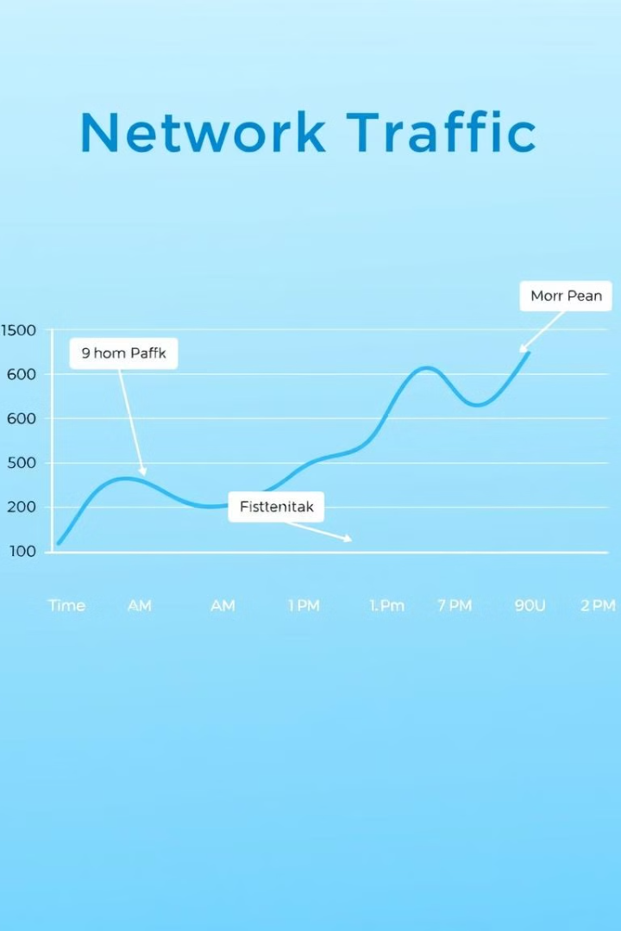
Network Congestion
Network congestion occurs when high traffic, low bandwidth, or a large number of users overload the network, diminishing WiFi performance. Monitoring network congestion involves collecting data from Wi-Fi router logs and SNMP monitoring tools. Patterns include peak times during work hours and fluctuating performance. Heatmaps and line charts are effective for visualizing network congestion, highlighting peak usage times and overall traffic trends. Analyzing these visualizations enables proactive network management.
High Traffic
Low Bandwidth
Many Users

Slide 8





Video Streaming & Browsing Performance
Video streaming and browsing performance depend on network congestion, latency, and packet loss, as well as DNS resolution and server response time. Data can be collected using tools like the Fast.com API, YouTube Data API, and WebPageTest. Common patterns include buffering issues and longer load times during high latency. Line charts and histograms are useful for visualizing these patterns, illustrating the impact of network issues on user experience.
1
Server Response Time
2
DNS Resolution
3
Latency
4
Packet Loss
5
Network Congestion

Slide 9

Tools & Libraries for WiFi Performance Analysis
Various tools and libraries facilitate WiFi performance analysis. For speed testing, speedtest-cli and the fast.com API are useful. Latency and packet loss can be measured using Ping and MTR. Wi-Fi Analyzer and pysnmp help in assessing signal strength and interference. SNMP monitoring tools are valuable for network congestion analysis, while Lighthouse and WebPageTest aid in evaluating web performance. These tools provide comprehensive data for informed decision-making and network optimization.
Speed Testing
speedtest-cli, fast.com API
Latency & Packet Loss
Ping, MTR
Signal Strength & Interference
Wi-Fi Analyzer, pysnmp

Slide 10

Conclusion: Optimizing WiFi Performance
Monitoring WiFi performance is vital for maintaining network efficiency and ensuring a seamless user experience. By leveraging data visualization and analysis tools, network issues can be promptly identified and resolved. Regular assessment and optimization ensure that the network operates at its best, providing improved connectivity and a better user experience. Consistent monitoring and proactive management are key to sustaining optimal WiFi performance.
Regular Assessment
Data Visualization
Proactive Management

